Slide 1
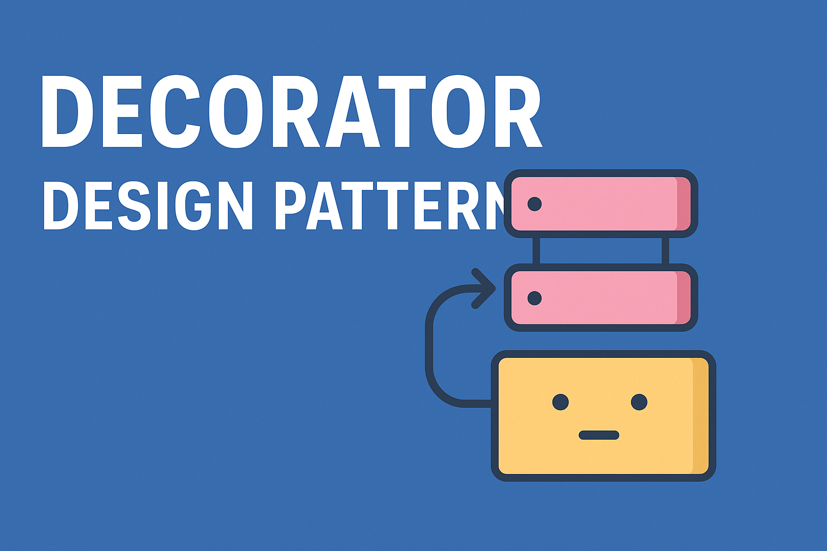
Decorator Design Pattern

Slide 2
Creational (5)
Factory
Structural (7)
Adapter
Behavioral (11)
Chain Of Responsibility
Abstract Factory
Singleton
Prototype
Builder
Bridge
Composite
Decorator
Facade
Flyweight
Proxy
Command
Interpreter
Iterator
Mediator
Memento
Observer
State
Strategy
Template
Visitor

Slide 3
OOP Principals
Class
Object
Constructors
Inheritance
Method Overriding
Encapsulation
Interfaces
Abstractions
Polymorphism

Slide 4

How would you model different types of coffee?
One class many properties?
Many classes?

Slide 5


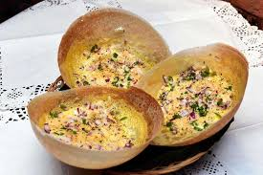

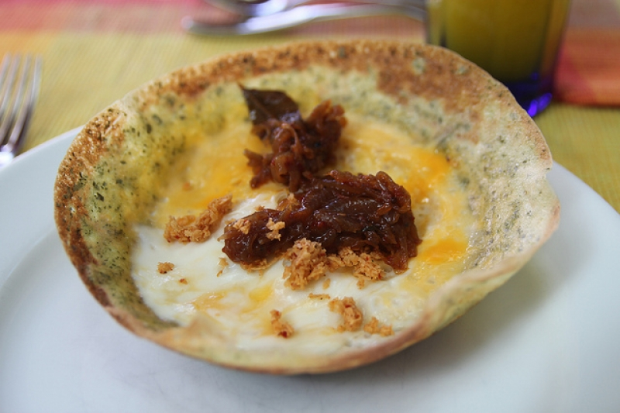
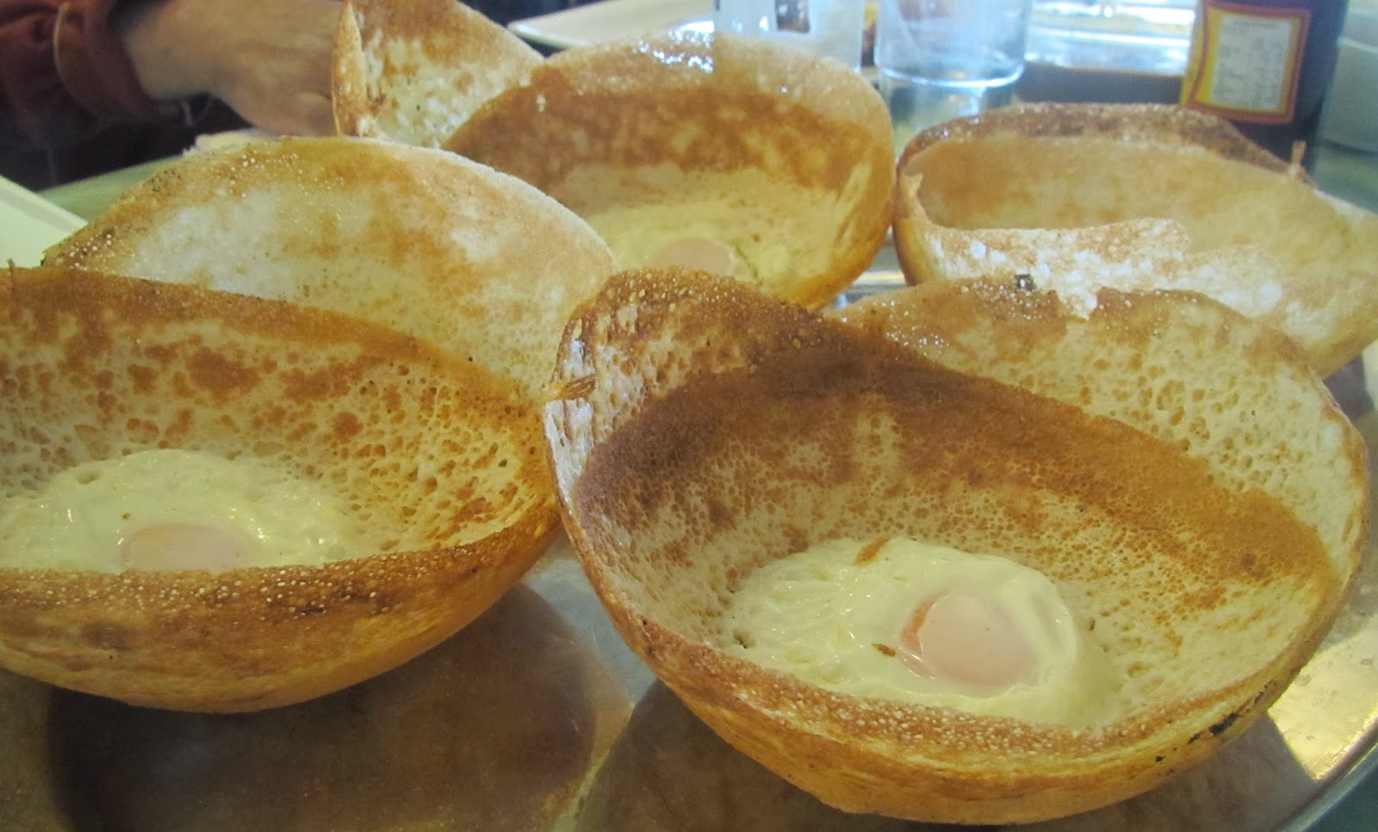

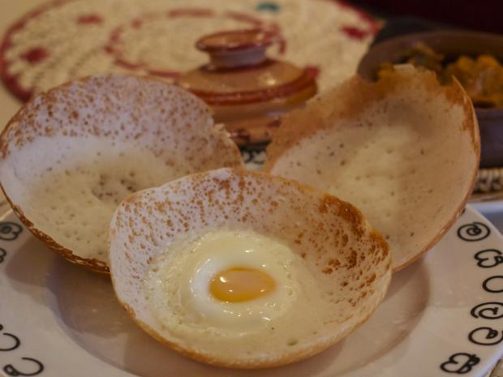

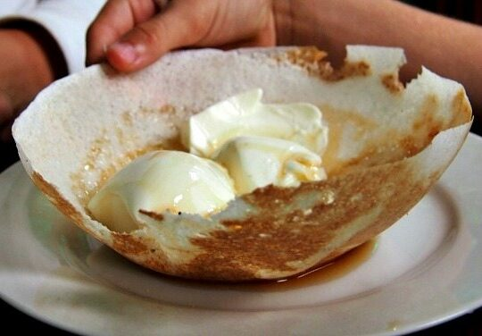
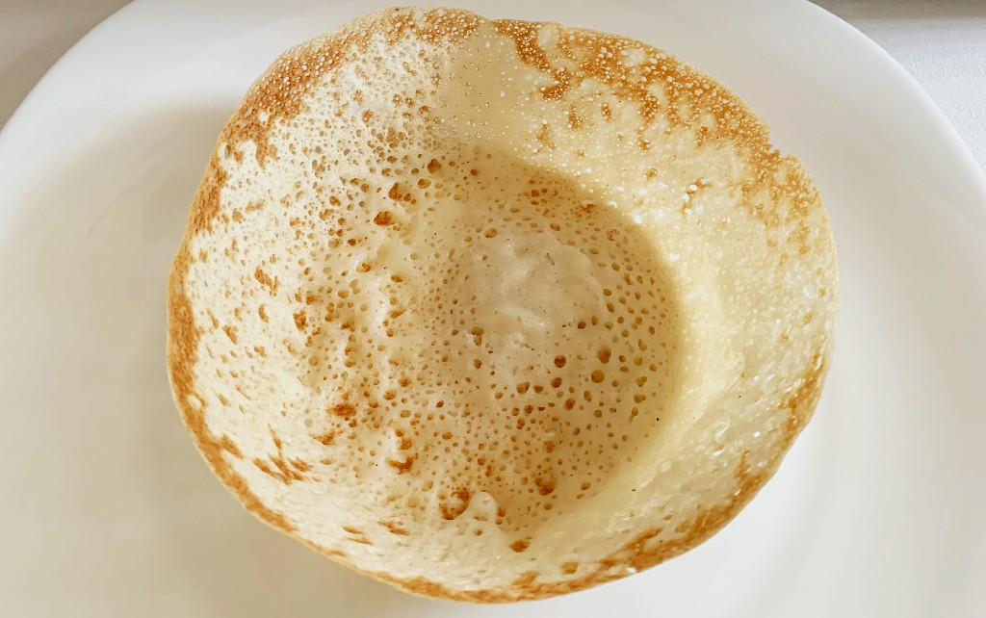

Slide 6
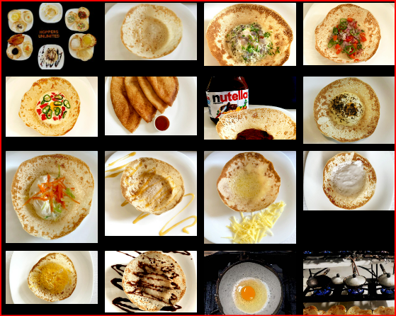
https://hoppersunlimited.com.au/varieties/

Slide 7
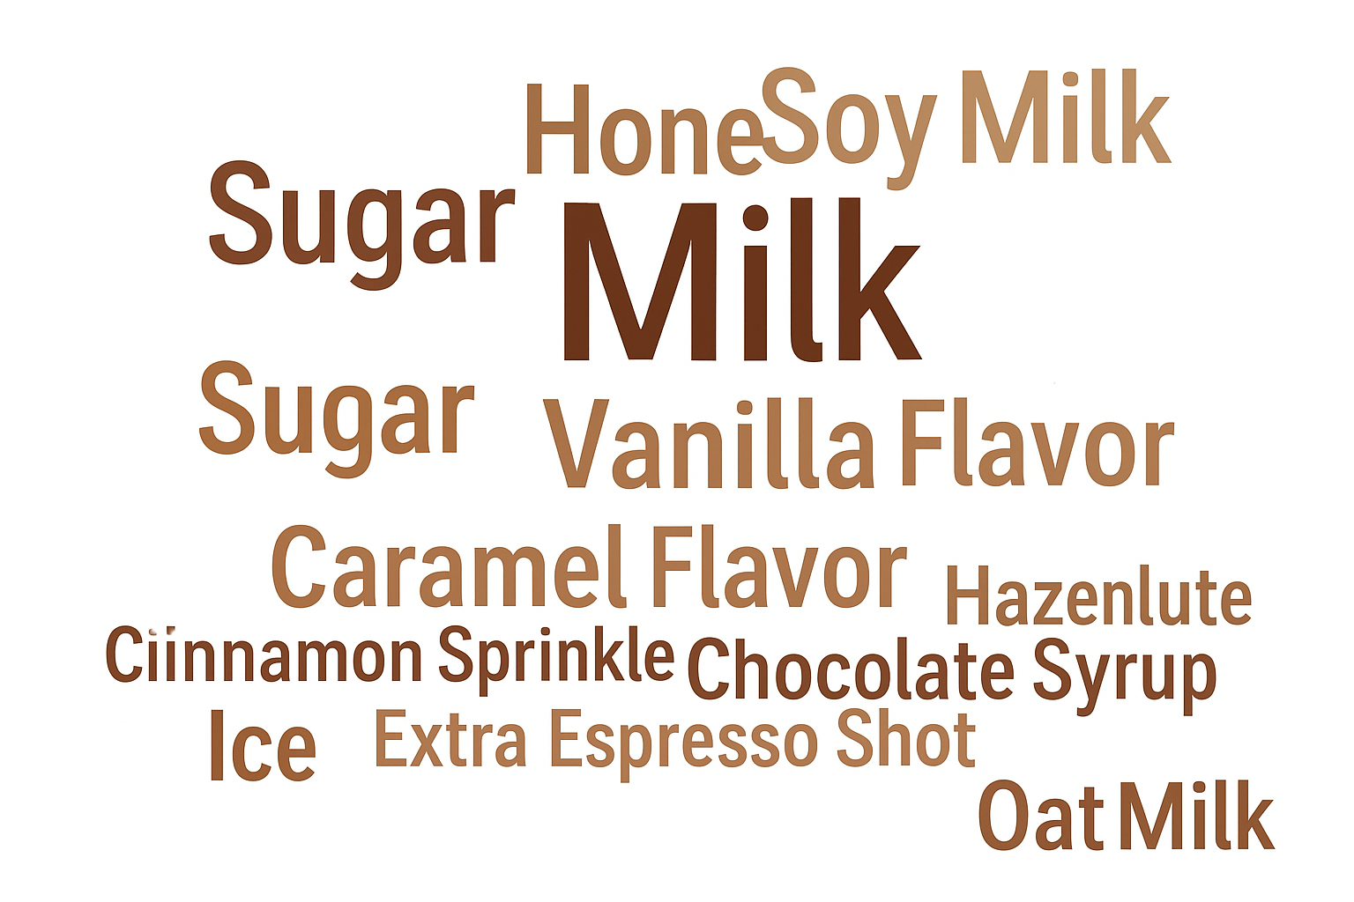
☕ Coffee Shop – Possible Add-ons

Slide 8
What are the combinations
Number of Properties | Combinations
3 | 8
5 | 252
10 | 1024
15 | 32,768
Combinations for n = 3
NULL
A
B
C
A,B
B,C
A,C
A,B,C

Slide 9
Add-ons / Ingredients
Milk
Sugar
Honey
Cream
Whipped Cream
Vanilla Flavor
Caramel Flavor
Hazelnut Flavor
Chocolate Syrup
Cinnamon Sprinkle
Ice
Extra Espresso Shot
Soy Milk
Almond Milk
Oat Milk
Size / Strength
Small Size
Medium Size
Large Size
Decaf
Extra Strong Brew
Serving Style
Takeaway Cup
Reusable Cup
Glass Mug
Seasonal / Special
Pumpkin Spice
Peppermint Flavor
Festive Toppings

Slide 10
Introduction
Allows behaviour / property to be added to an individual object without impacting the behaviour of the class.
This can be added statistically or dynamically.
Alternative for sub classing and avoid many number of classes or many number of attributes

Slide 11
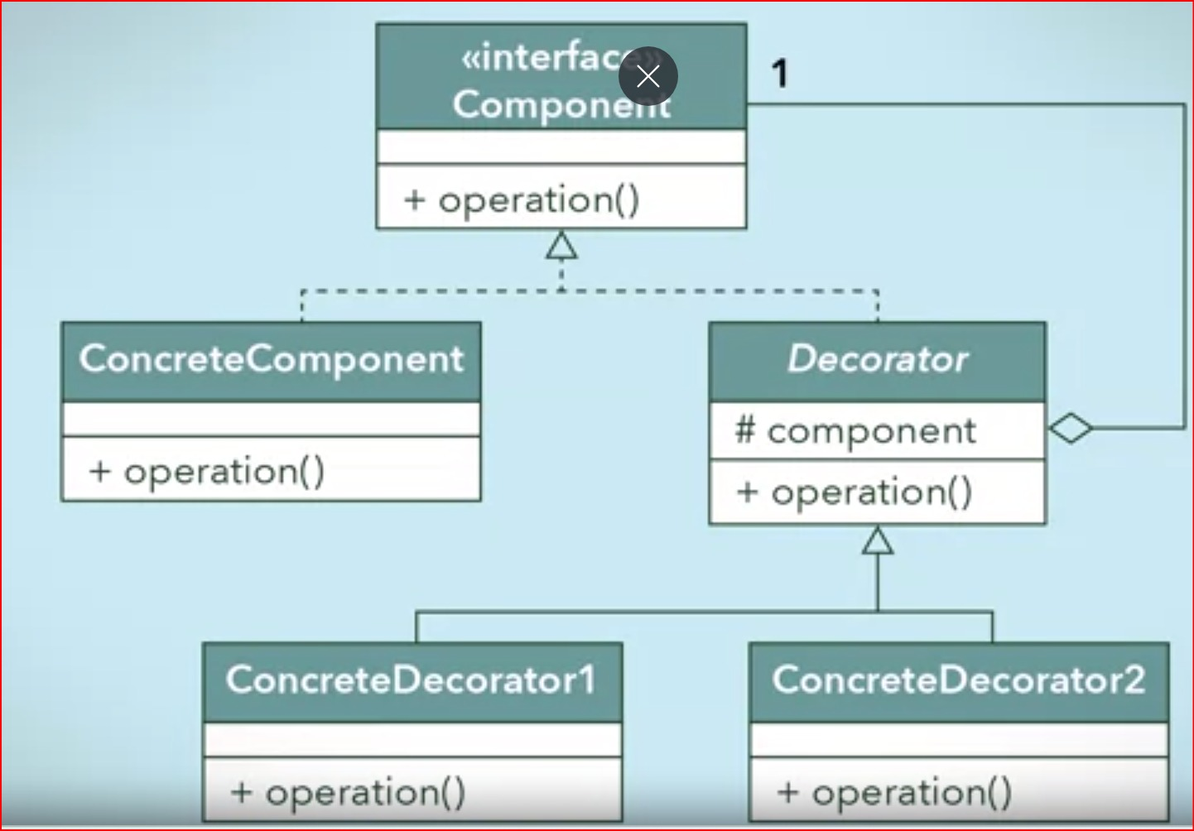

Slide 12
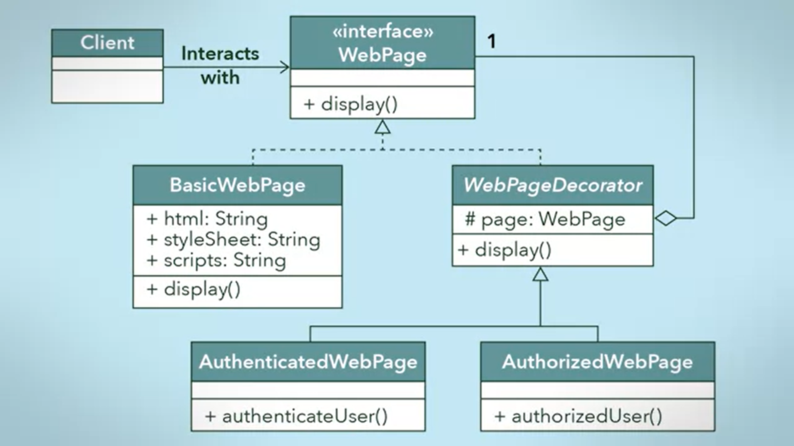

Slide 13
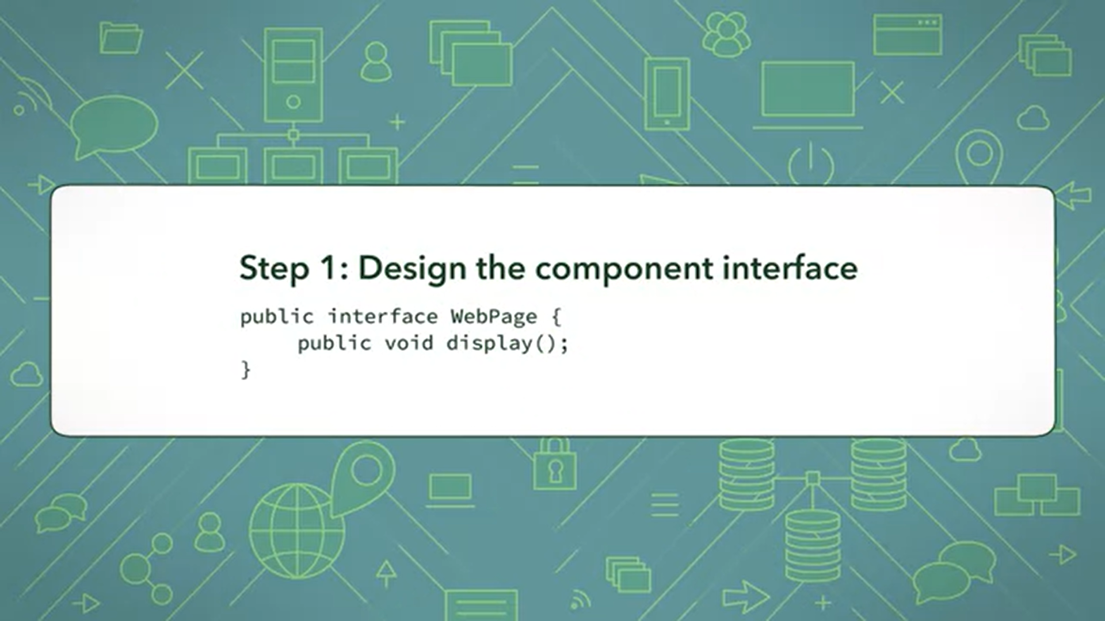

Slide 14
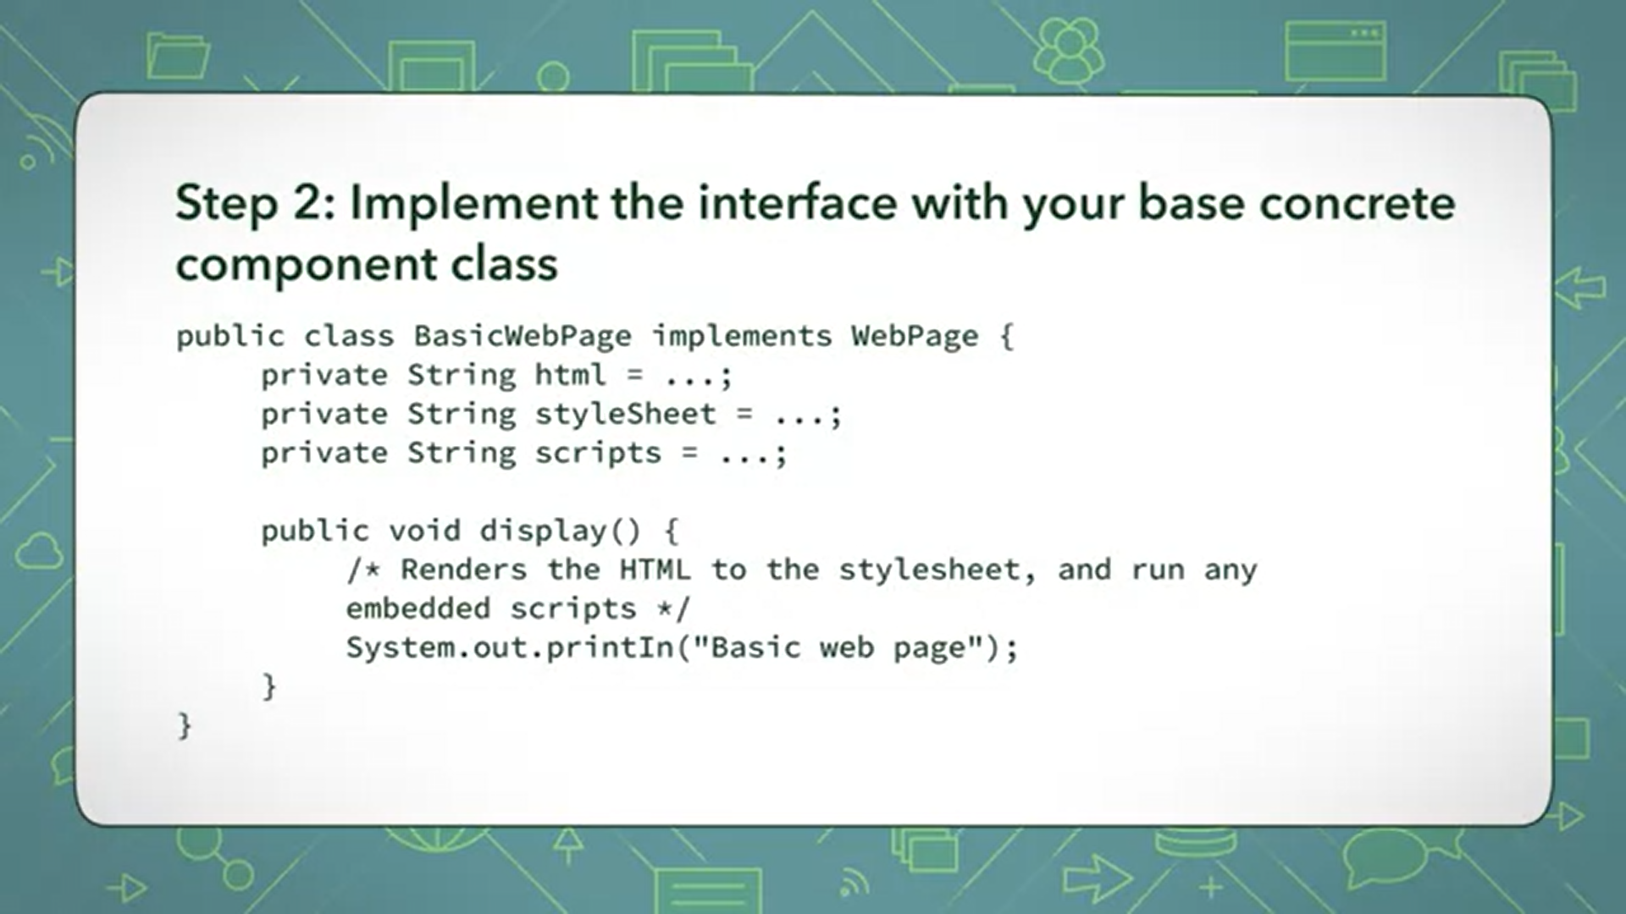

Slide 15
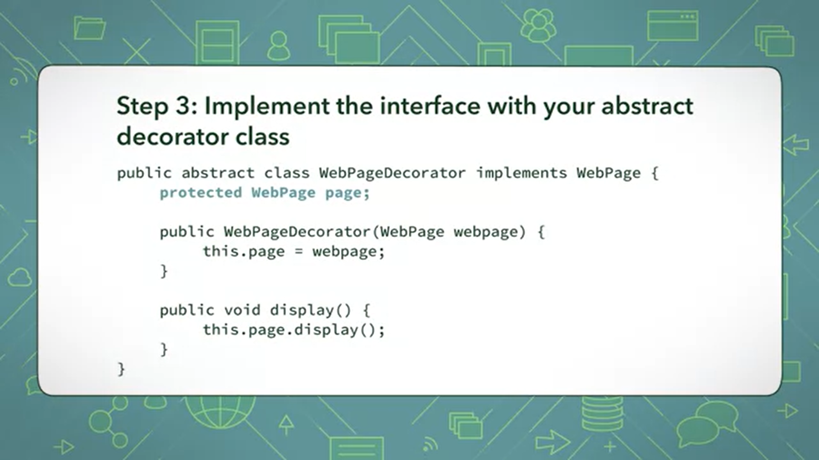

Slide 16
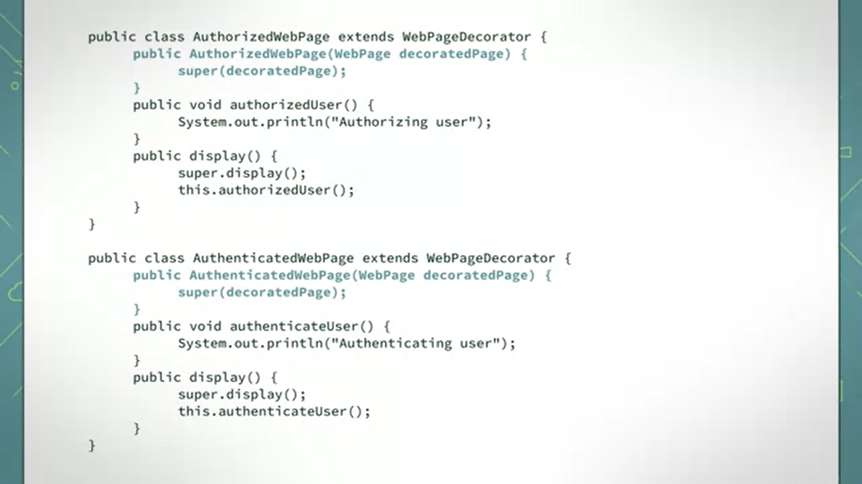

Slide 17


Slide 18
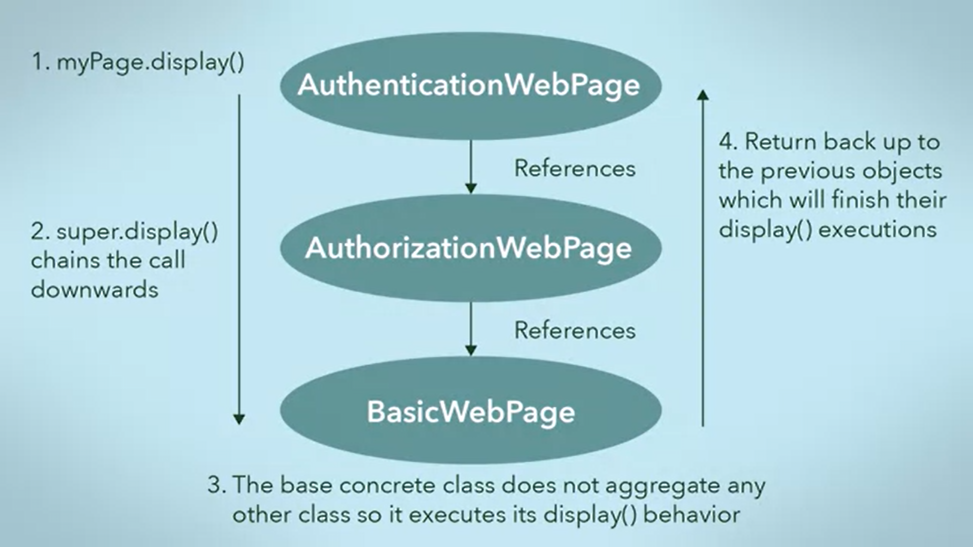

Slide 19
What are the reasons for using the decorator design pattern?
The decorator design pattern allows objects to dynamically add behaviors to others.
To hide a complex, and resource demanding object until it is needed.
To reduce the number of classes needed to offer a combination of behaviors.
It lets you build a tree-like structure of objects that can be treated as a single, uniform object type.

Slide 20
What is the difference between proxy and decorator design pattern?
A protection proxy might be implemented like a decorator, but you should not forget the intent of a proxy.
Decorators focus on adding responsibilities, but proxies focus on controlling the access to an object.
Proxies differ from each other through their types and implementations.
If you can remember their purposes, in most cases you will be able to clearly distinguish proxies from decorators

Slide 21
What are the key advantages of using a decorator
The existing structure is untouched, so you cannot introduce bugs there.
New functionalities can be added to an existing object easily.
You do not need to predict/implement all the supported functionalities at once (in other words, in the initial design phase). You can develop incrementally.

Slide 22
What are the disadvantages associated with this pattern?
Separate core and decorator features.
If you create too many decorators in the system, it will be hard to maintain and debug. So, in that case, they can create unnecessary confusion.
Handling conflicts between decorators.

Slide 23
Reflective Questions
When designing a system, what advantages does using the Decorator pattern provide compared to simply adding new functionality through inheritance?
How does the Decorator pattern support the Open/Closed Principle (open for extension, closed for modification)? Can you think of a scenario from your own coding experience where this would be useful?
What are some potential drawbacks of using multiple decorators in a system, and how might you balance flexibility with complexity?

